Slide 1
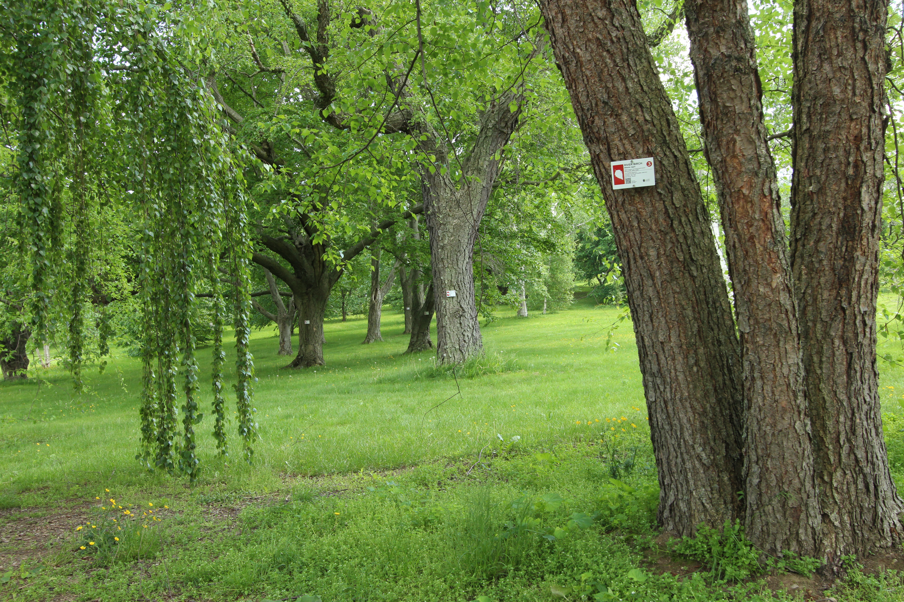




Tree Spotters 2018 BBQ
Arnold Arboretum
Temporal Ecology Lab, Harvard University
Cat Chamberlain, Graduate Student
Suzanne Mrozak, Volunteer Coordinator
Danny Schissler, Intern

Slide 2
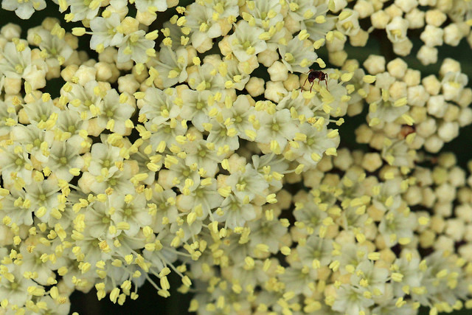
OVERVIEW
2018 SPRING REVIEW
AMAZING DATA!
SOME RESEARCH PLANS
NEW SPECIES ROLL-OUT
WHAT DO YOU WANT TO KNOW?
THANK YOU!

Slide 3
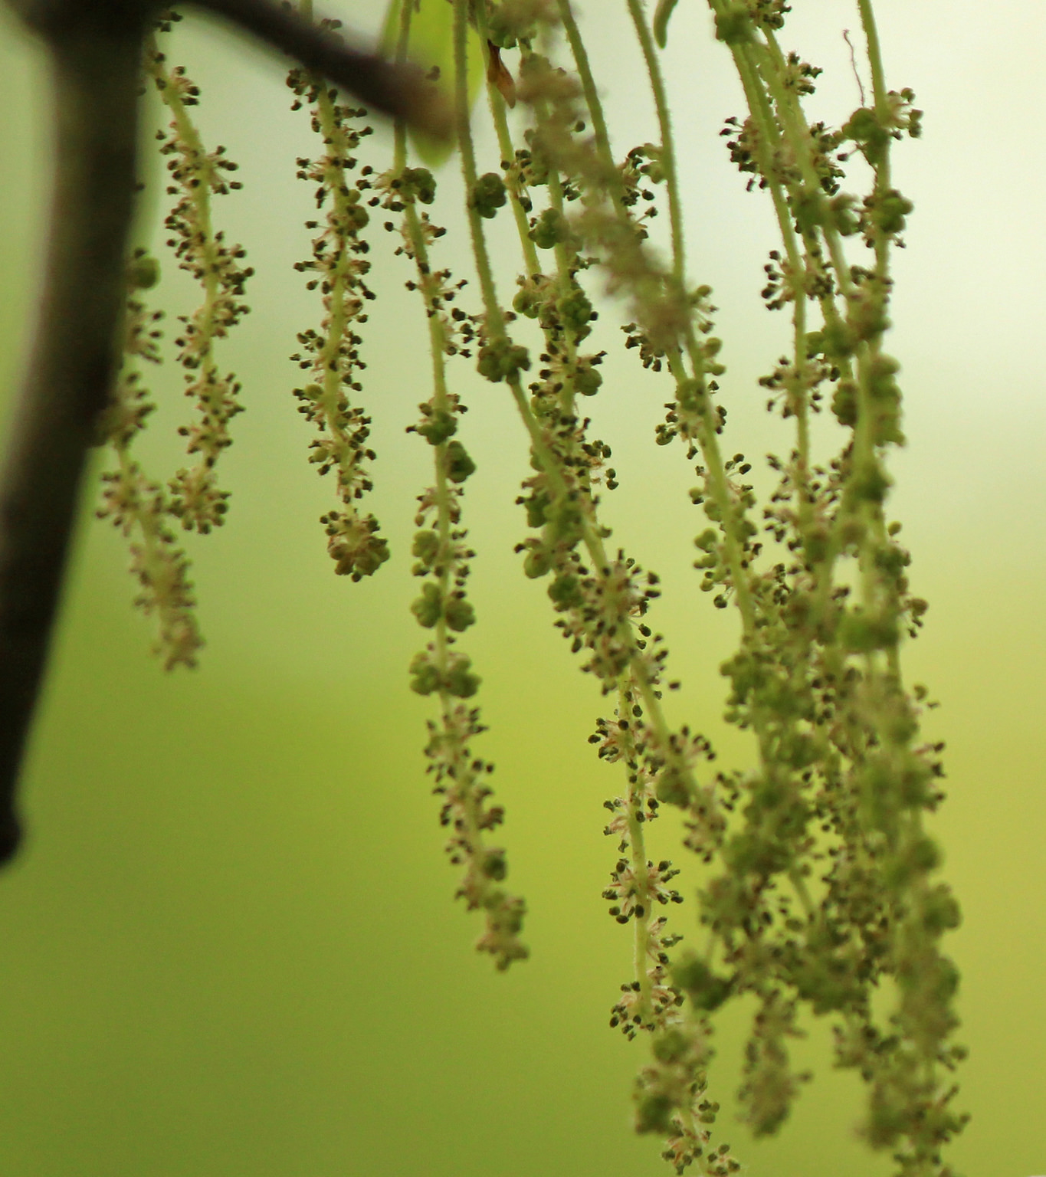
THE NUMBERS
OBSERVATIONS FOR…
2016:
53,502
2017:
66,112
2018:
33,021
TOTAL:
165,200

Slide 4
THE NUMBERS
OBSERVATIONS FOR…
2016:
53,502
2017:
66,112
2018:
33,021
TOTAL:
165,200
OBSERVERS FOR…

